Slide 1
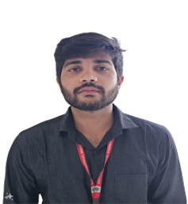
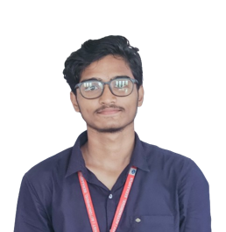

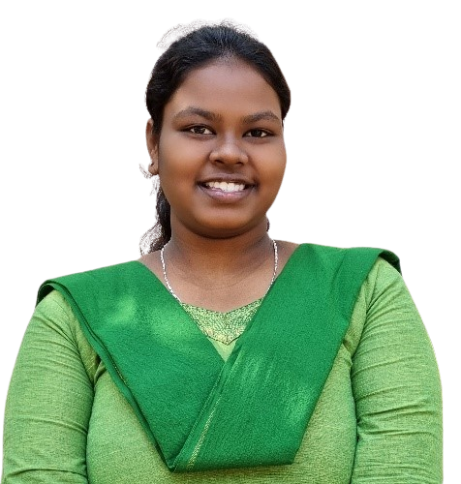
Enhanced CBIR System for Commercial Applications
Project ID: 31139
V.Litesh Kumar CSE 202110124
Silla Suhani CSE 202113343
Param Jyoti Sahu CSE 202140150
Nikhil Patnaik CSE 202110154
By
Under the guidance of
Dr. Charulata Palai
202110124 V.Litesh Kumar 202113343 Silla Suhani 202140150 Paramjyoti Sahu 202110154 Nikhil Patnaik
Notes:
B-TECH PROJECT MID-SEM PRESENTATION 2011
BY KHUSHBU KHAN & ISAN SAHOO

Slide 2
CONTENTS
INTRODUCTION
OBJECTIVES
CHALLENGES
LITERATURE SURVEY
METHODOLOGY
PROPOSED MODEL
RETRIEVAL RESULTS
RESULTS
CONCLUSION
REFERENCE
202110124 V.Litesh Kumar 202113343 Silla Suhani 202140150 Paramjyoti Sahu 202110154 Nikhil Patnaik
Notes:
B-TECH PROJECT MID-SEM PRESENTATION 2011
BY KHUSHBU KHAN & ISAN SAHOO
2

Slide 3
INTRODUCTION
The growth of e-commerce has led to innovative solutions to enhance product search and user experience.
Limitations of Traditional Search: Text-based methods often fall short when users have only a visual reference.
Content-Based Image Retrieval (CBIR): Allows searches based on image similarity, where users can upload an image and retrieve visually similar items from a product catalog.
Project Focus: This CBIR project targets fashion items using deep learning model built on ResNet-50, VGG16, and Hybrid Model(VGG16 + EfficientNetB0 + MobileNetV3Small an effective architecture for visual feature extraction.
202110124 V.Litesh Kumar 202113343 Silla Suhani 202140150 Paramjyoti Sahu 202110154 Nikhil Patnaik
Notes:
B-TECH PROJECT MID-SEM PRESENTATION 2011
BY KHUSHBU KHAN & ISAN SAHOO
3

Slide 4
OBJECTIVE
Enhance Search Accuracy:
To improve the precision of search results by leveraging visual features for better matching.
Resolve Metadata Limitations:
To reduce dependency on manual tagging and inconsistent metadata to improve search reliability.
Boost Search Efficiency:
To increase the speed and relevance of search results for quicker and more effective product discovery.
Drive Business Growth:
To increase conversion rates and customer satisfaction by enhancing product visibility and discovery.
202110124 V.Litesh Kumar 202113343 Silla Suhani 202140150 Paramjyoti Sahu 202110154 Nikhil Patnaik
Notes:
B-TECH PROJECT MID-SEM PRESENTATION 2011
BY KHUSHBU KHAN & ISAN SAHOO
4

Slide 5
CHALLENGES
High Computational Cost: Feature extraction from images using deep learning models like CNN requires significant computational resources, especially for large databases.
Diversity in Fashion Styles: Fashion items vary widely in style, color, and texture. Capturing these nuances and making accurate matches across such diverse items is complex.
Storage and Memory Constraints: Storing feature vectors for a large number of images requires substantial memory, and managing this data efficiently is essential to avoid performance bottlenecks.
202110124 V.Litesh Kumar 202113343 Silla Suhani 202140150 Paramjyoti Sahu 202110154 Nikhil Patnaik
Notes:
B-TECH PROJECT MID-SEM PRESENTATION 2011
BY KHUSHBU KHAN & ISAN SAHOO
5

Slide 6

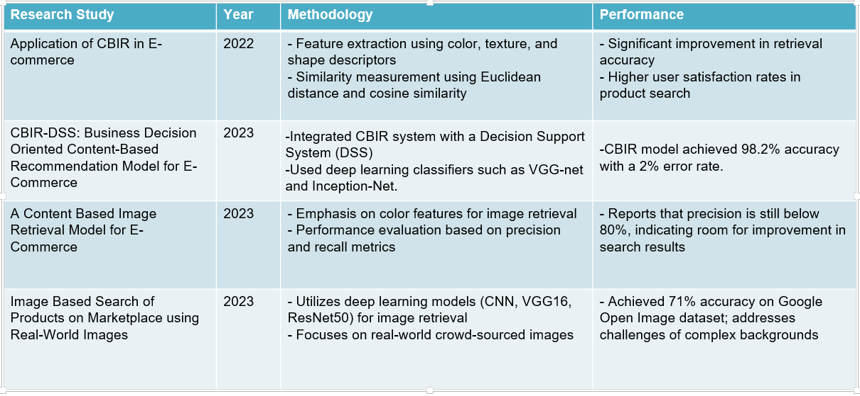
LITERATURE SURVEY
National Institute of Science & Technology
4
202110124 V.Litesh Kumar 202113343 Silla Suhani 202140150 Paramjyoti Sahu 202110154 Nikhil Patnaik

Slide 7
METHODOLOGY
Data Preparation:
The Fashion-MNIST dataset, containing 10 categories (e.g., T-shirts, trousers), provides the foundation for training. Images are resized to 24x24 pixels and organized by category to streamline training and feature extraction.
Model Architecture:
ResNet-50, VGG16, and Hybrid Model(VGG16 + EfficientNetB0 + MobileNetV3Small) are adapted by replacing their final layers with custom fully connected layers. This modification allows the model to generate feature vectors focused on fine details like patterns and textures.
Feature Extraction:
Each image is processed through the respective modified models to produce a feature vector.
These vectors, representing unique products, are stored in a database for fast retrieval during searches.
Similarity Measurement:
Cosine similarity is used to compare query and database vectors, ranking items by similarity score.
202110124 V.Litesh Kumar 202113343 Silla Suhani 202140150 Paramjyoti Sahu 202110154 Nikhil Patnaik
Notes:
B-TECH PROJECT MID-SEM PRESENTATION 2011
BY KHUSHBU KHAN & ISAN SAHOO
7

Slide 8
PROPOSED MODEL
Query image
Image collection
Feature extraction
Feature extraction
Query image
Features
Similarities measures
Feature Database
Retrieved results
202110124 V.Litesh Kumar 202113343 Silla Suhani 202140150 Paramjyoti Sahu 202110154 Nikhil Patnaik
Notes:
B-TECH PROJECT MID-SEM PRESENTATION 2011
BY KHUSHBU KHAN & ISAN SAHOO
8

Slide 9
PROPOSED MODEL
(Hybrid model = VGG16 + EfficientNetB0 + MobileNetV3Small)
The image shows a deep learning architecture diagram that combines multiple pretrained models. Here are key points you could mention in your presentation:
Multi-model ensemble architecture - The diagram shows an ensemble of three pretrained models (VGG16, EfficientNetB0, and MobileNetV3Small) working in parallel
Feature extraction approach - Each pretrained model is frozen and used as a feature extractor, producing 512, 1280, and 576 features respectively
Global pooling layer - Each model's output passes through a GlobalAveragePooling2D layer to reduce dimensions
Feature concatenation - The features from all three models are concatenated, resulting in 2368 combined features
Dense layers for refinement - The concatenated features pass through two dense layers with ReLU activation (512 and 256 neurons)
Dual output branches - The network splits into two output heads: a feature extractor (CBIR) and a classification layer (10 classes with Softmax)
Input specifications - The model accepts 224×224×3 images as input
Transfer learning paradigm - Leverages knowledge from pretrained models while adding custom layers for specific tasks
Hybrid architecture - Combines lightweight models (MobileNet) with deeper models (VGG16) to balance efficiency and performance
202110124 V.Litesh Kumar 202113343 Silla Suhani 202140150 Paramjyoti Sahu 202110154 Nikhil Patnaik
Notes:
B-TECH PROJECT MID-SEM PRESENTATION 2011
BY KHUSHBU KHAN & ISAN SAHOO
9

Slide 10
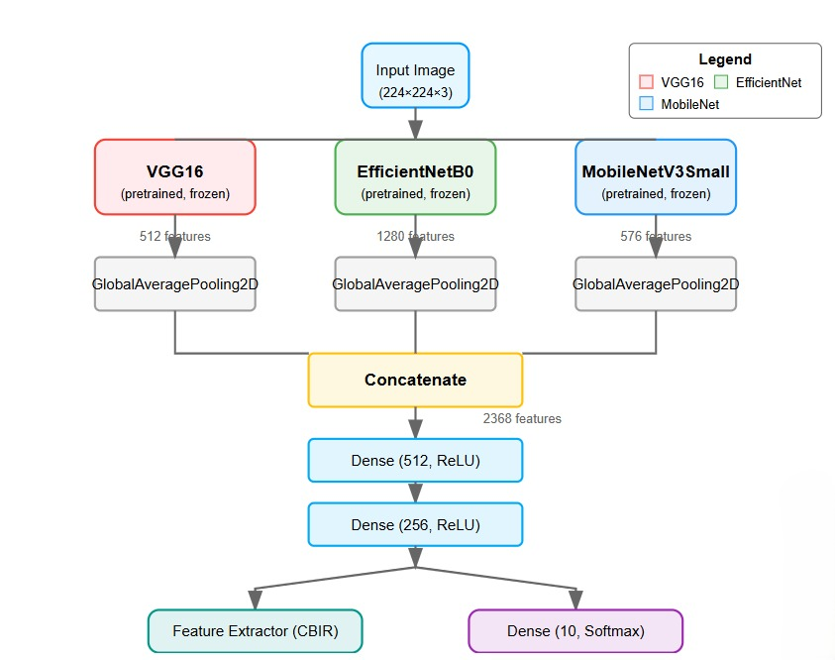
PROPOSED MODEL (Hybrid model = VGG16 + EfficientNetB0 + MobileNetV3Small)
202110124 V.Litesh Kumar 202113343 Silla Suhani 202140150 Paramjyoti Sahu 202110154 Nikhil Patnaik
Notes:
B-TECH PROJECT MID-SEM PRESENTATION 2011
BY KHUSHBU KHAN & ISAN SAHOO
10

Slide 11
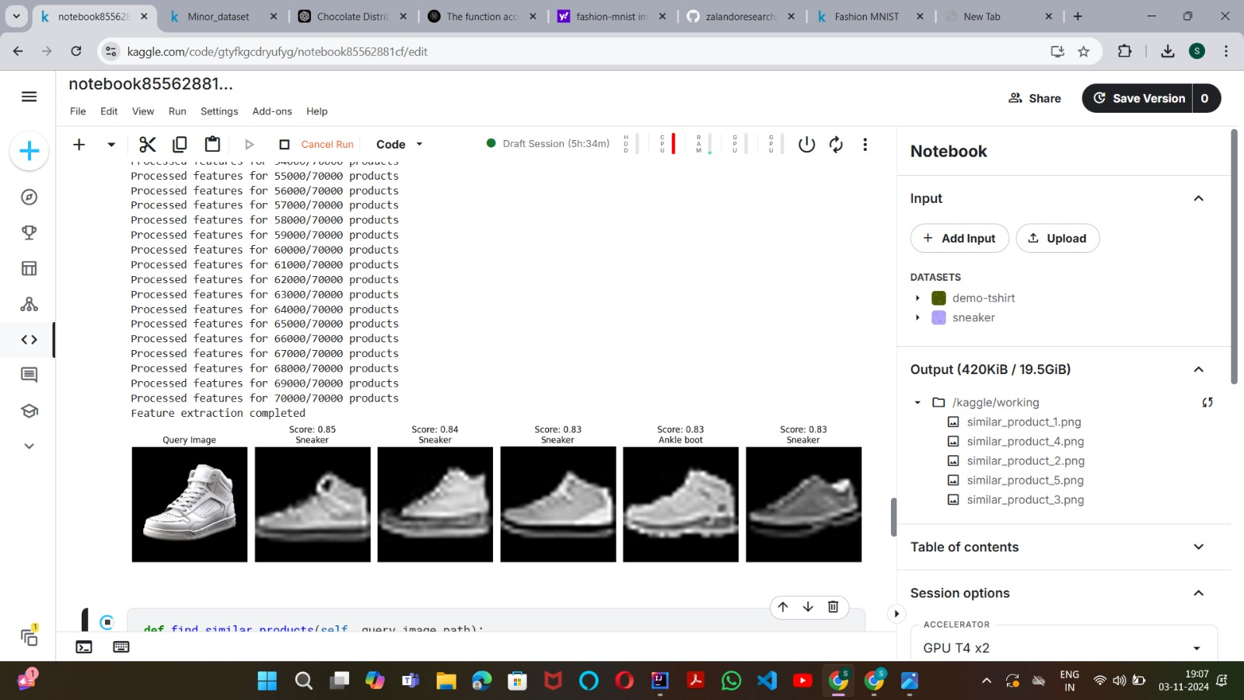
Retrieval Result of ResNet50 Model
Similar images are being fetched based on the query image.i
202110124 V.Litesh Kumar 202113343 Silla Suhani 202140150 Paramjyoti Sahu 202110154 Nikhil Patnaik
Notes:
B-TECH PROJECT MID-SEM PRESENTATION 2011
BY KHUSHBU KHAN & ISAN SAHOO
11

Slide 12
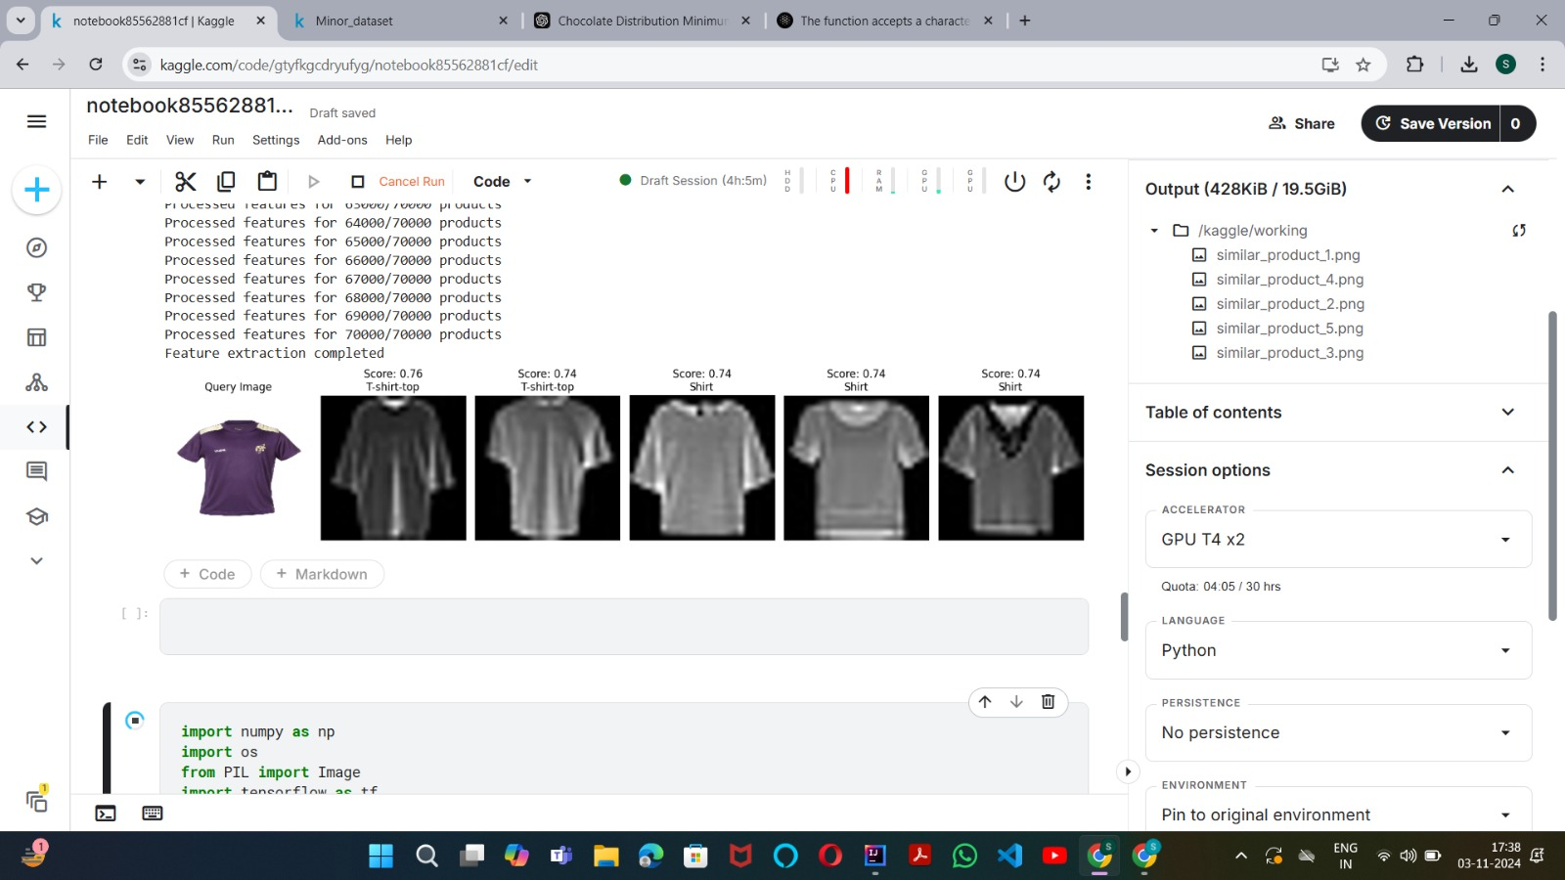
Retrieval Result of ResNet50 Model
202110124 V.Litesh Kumar 202113343 Silla Suhani 202140150 Paramjyoti Sahu 202110154 Nikhil Patnaik

Slide 13
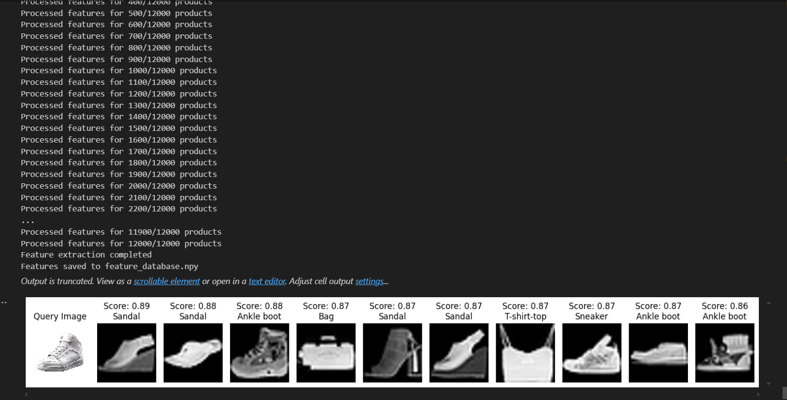
Retrieval Result of VGG16 Model
Output of VGG16 Model:i

Slide 14
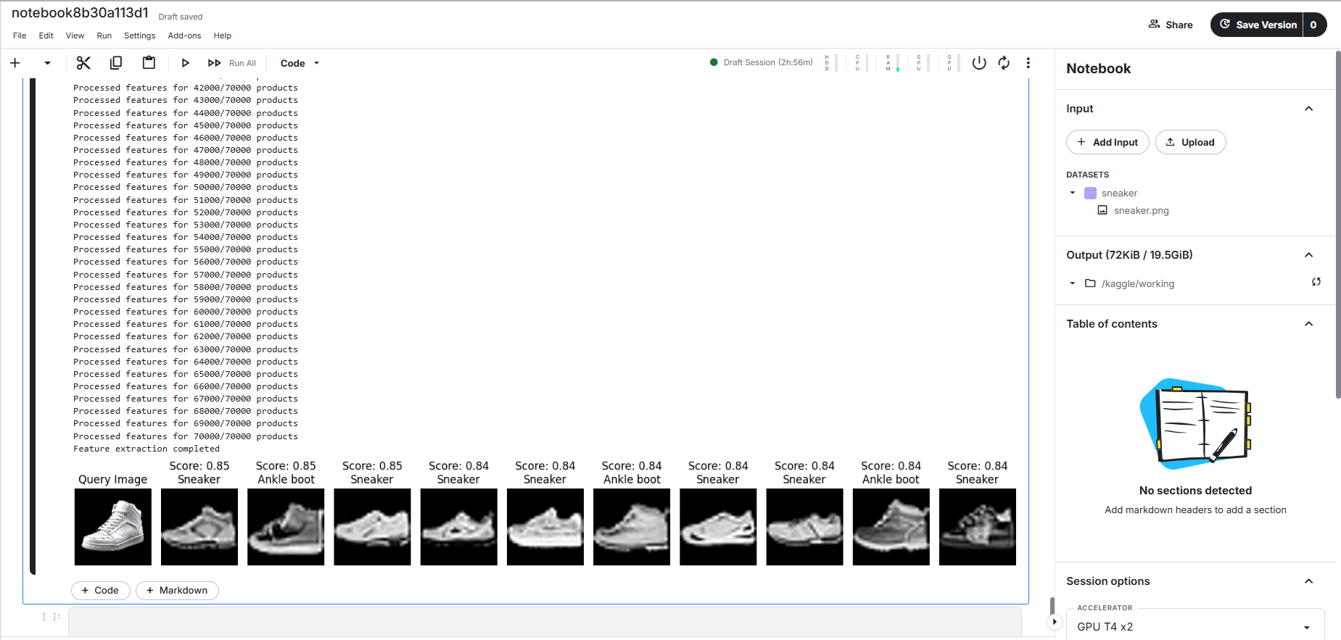
Retrieval Result of Proposed(Hybrid) Model
Output of Hybrid Model (VGG16 + EfficientNetB0 + MobileNetV3Small):i

Slide 15
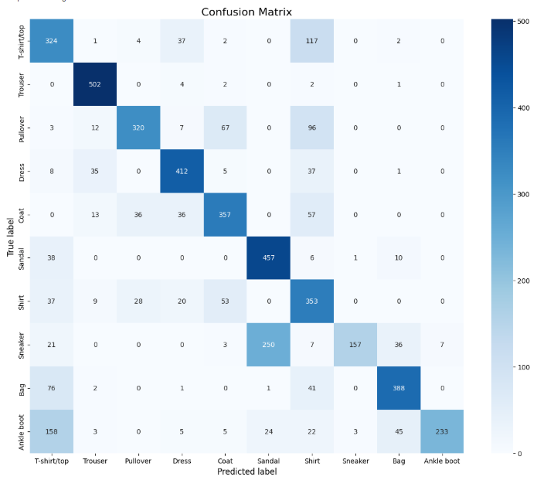
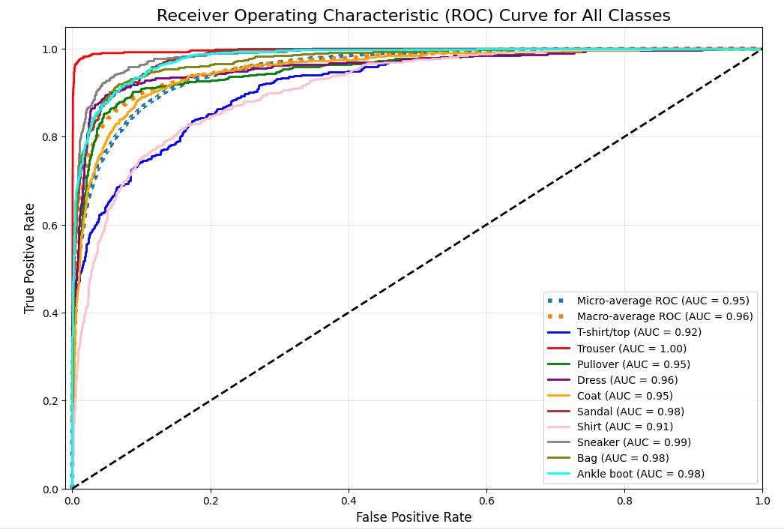
Results of ResNet50 Model
Model: ResNet50
ROC Curve
Confusion Matrix
202110124 V.Litesh Kumar 202113343 Silla Suhani 202140150 Paramjyoti Sahu 202110154 Nikhil Patnaik

Slide 16
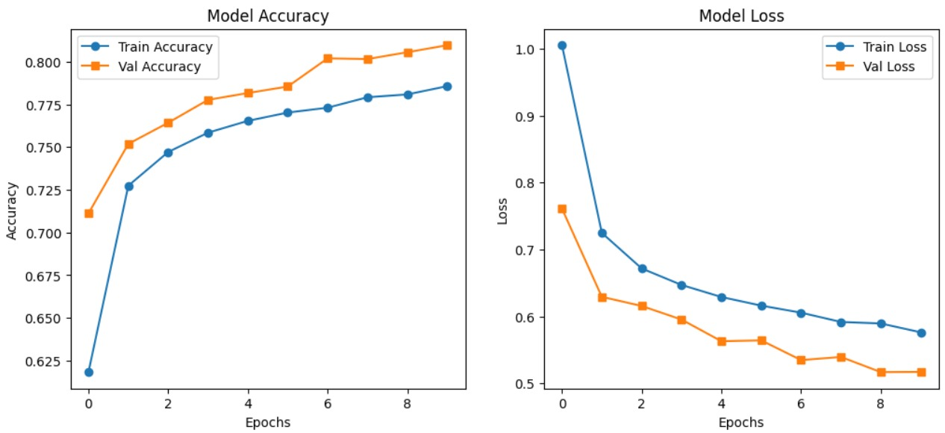
Results of ResNet50 Model
202110124 V.Litesh Kumar 202113343 Silla Suhani 202140150 Paramjyoti Sahu 202110154 Nikhil Patnaik

Slide 17
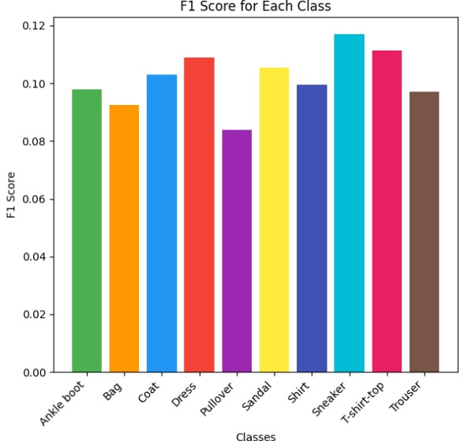
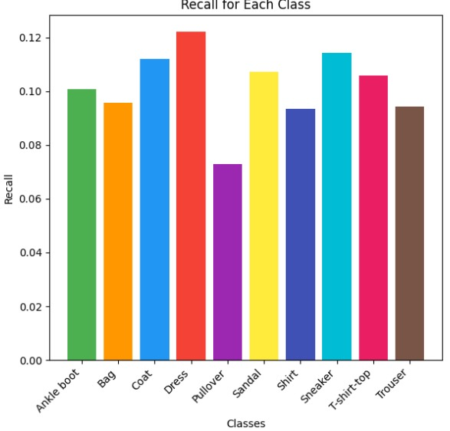
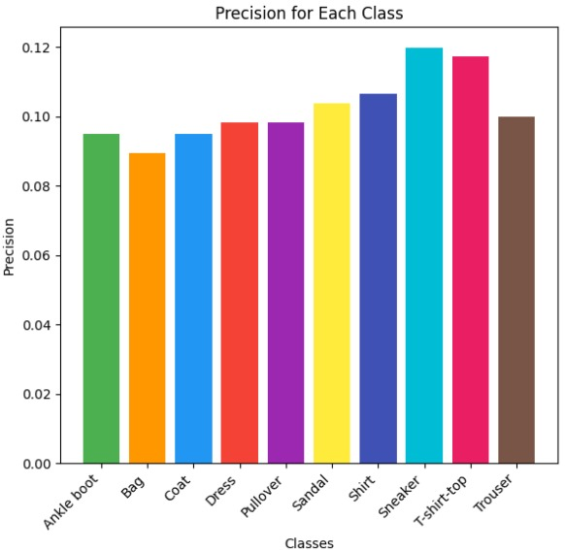
Results Of ResNet50 Model
F1 score :
A single metric that combines precision and recall using the harmonic mean. It's a balanced evaluation of a model's performance, and is preferable to accuracy for class-imbalanced datasets. F1 score ranges from 0 to 1, with 1 representing perfect precision and recall, and 0 indicating poor performance.
Recall :
Measures how well a model identifies all data points in a relevant class. It's calculated by dividing the number of true positives (TP) by the sum of TP and false negatives (FN). Recall is also known as the true positive rate or sensitivity.
Precision :
Measures how well a model returns only the data points in a class. It's calculated by dividing the number of correct positive predictions by the total number of positive predictions.
202110124 V.Litesh Kumar 202113343 Silla Suhani 202140150 Paramjyoti Sahu 202110154 Nikhil Patnaik

Slide 18
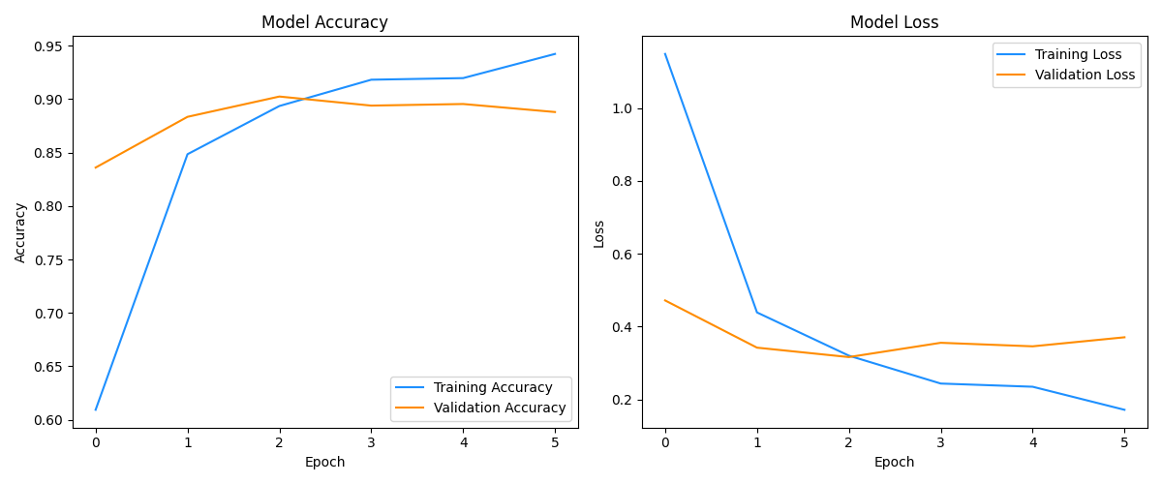
Results Of VGG16 Model
Model: VGG16
202110124 V.Litesh Kumar 202113343 Silla Suhani 202140150 Paramjyoti Sahu 202110154 Nikhil Patnaik

Slide 19
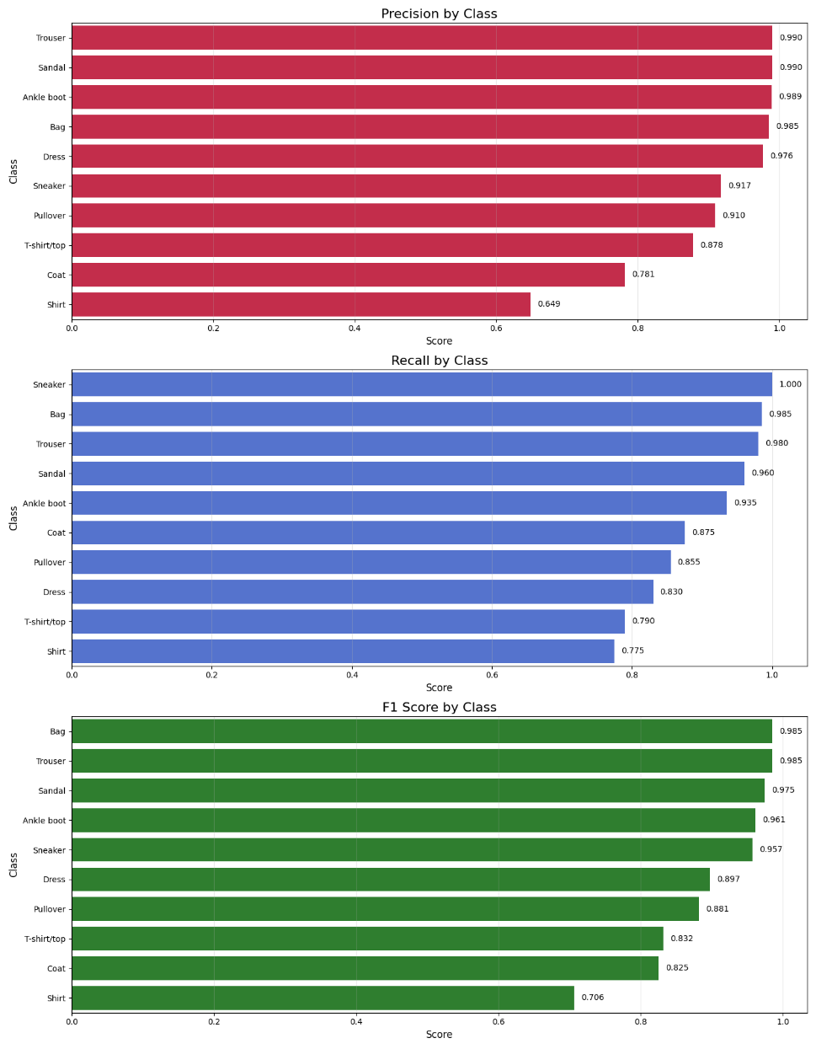
Results of VGG16 Model
Model: VGG16
202110124 V.Litesh Kumar 202113343 Silla Suhani 202140150 Paramjyoti Sahu 202110154 Nikhil Patnaik

Slide 20
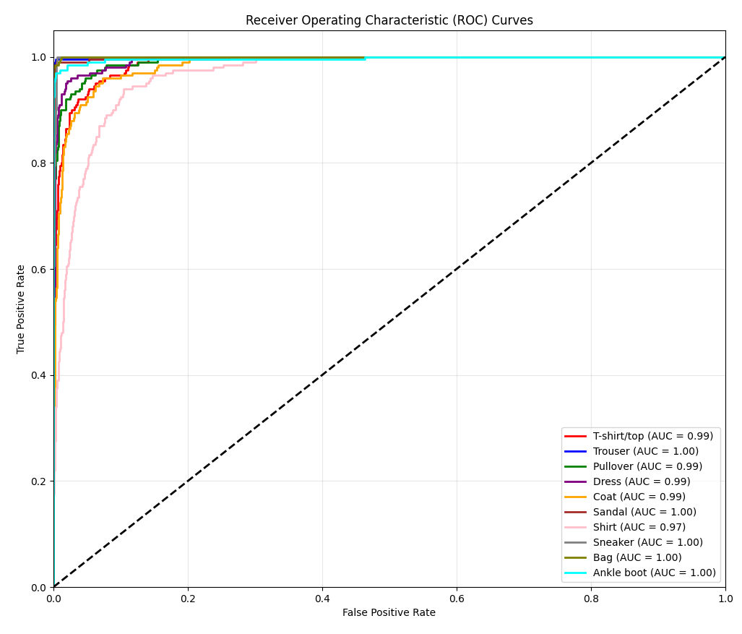
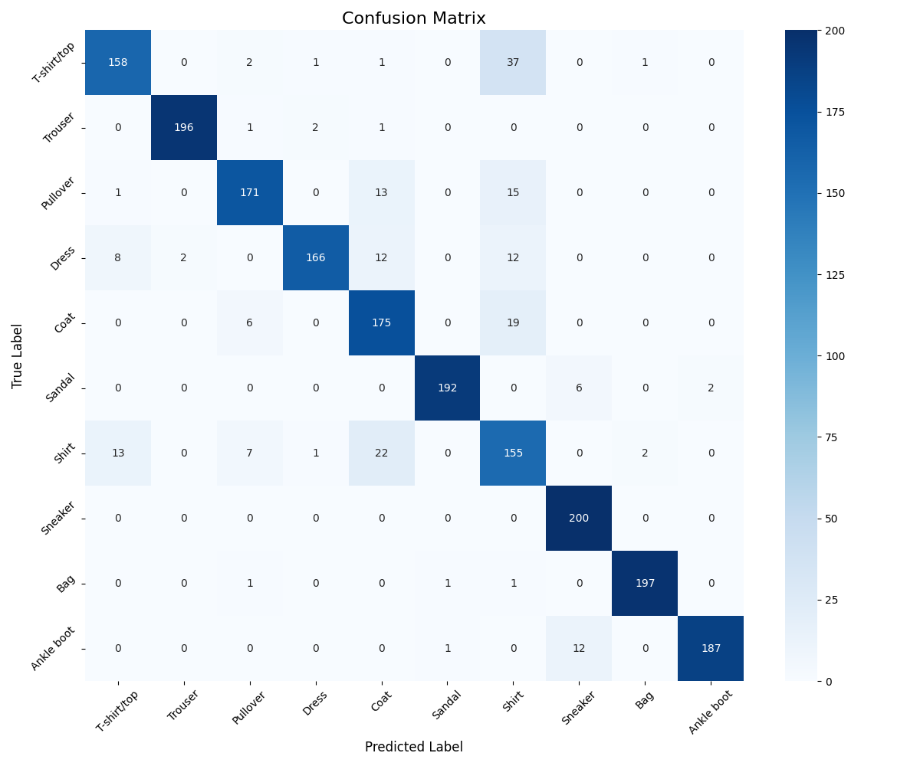
Results of VGG16 Model
ROC Curve Confusion Matrix
202110124 V.Litesh Kumar 202113343 Silla Suhani 202140150 Paramjyoti Sahu 202110154 Nikhil Patnaik

Slide 21
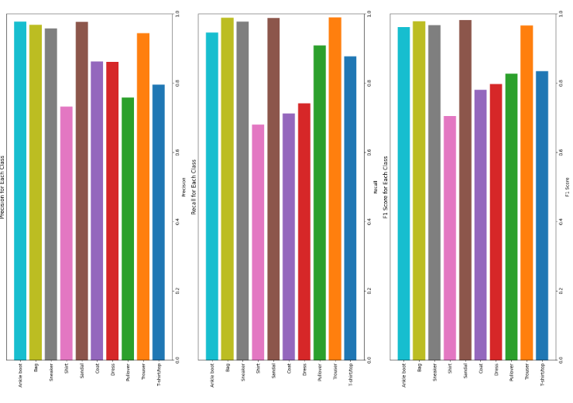
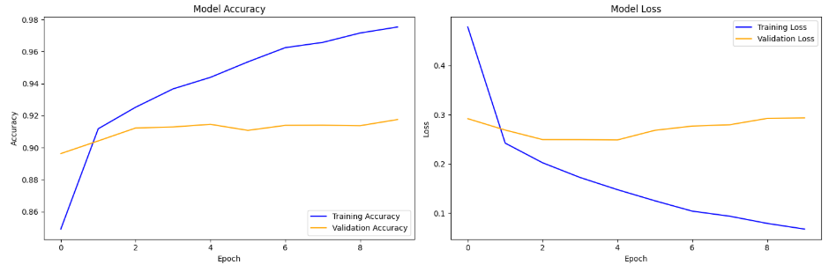
Results of Proposed Hybrid Model
Model: Hybrid Model (vgg16 + efficientnet + mobilenet)
202110124 V.Litesh Kumar 202113343 Silla Suhani 202140150 Paramjyoti Sahu 202110154 Nikhil Patnaik

Slide 22
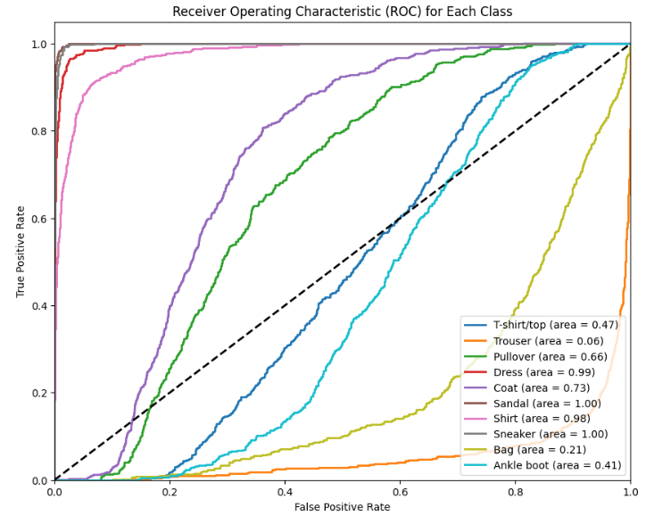
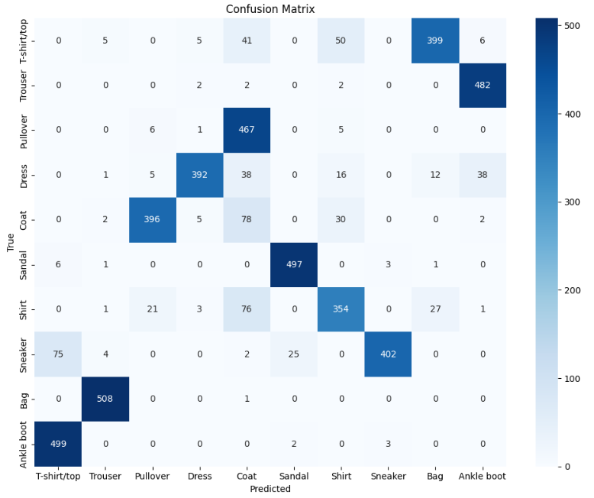
Results of Proposed Hybrid Model
Model: Hybrid Model (vgg16 + efficientnet + mobilenet)
ROC Curve Confusion Matrix
202110124 V.Litesh Kumar 202113343 Silla Suhani 202140150 Paramjyoti Sahu 202110154 Nikhil Patnaik

Slide 23
CONCLUSION
CONCLUSION :
The project demonstrates CBIR’s potential in e-commerce, achieving 87% accuracy on Fashion MNIST using ResNet50.
The model effectively identifies visual similarities, enhancing search accuracy and addressing challenges with text-based searches.
Future Work:
Diverse Datasets: Extend to colored and high-resolution images for wider product categories.
RealTime Processing: Optimize for faster retrievals.
Personalized Results: Integrate user preferences for tailored recommendations.
202110124 V.Litesh Kumar 202113343 Silla Suhani 202140150 Paramjyoti Sahu 202110154 Nikhil Patnaik

Slide 24
Reference
[1] Singh, Sachendra & Batra, Shalini. (2020). An efficient bi-layer content based image retrieval system. Multimedia Tools and Applications. 79. 10.1007/s11042-019-08401-7.
[2] Bagwari, A.; Sinha, A.; Singh, N.K.; Garg, N.; Kanti, J. CBIR-DSS: Business Decision Oriented Content-Based Recommendation Model for E-Commerce. Information 2022, 13, 479.
[3] V. Kodgirwar, "Application of content based image retrieval for E-commerce," 2016 World Conference on Futuristic Trends in Research and Innovation for Social Welfare (Startup Conclave), Coimbatore, India, 2016, pp. 1-3, doi: 10.1109/STARTUP.2016.7583906.
202110124 V.Litesh Kumar 202113343 Silla Suhani 202140150 Paramjyoti Sahu 202110154 Nikhil Patnaik

Slide 25
Thank You.
202110124 V.Litesh Kumar 202113343 Silla Suhani 202140150 Paramjyoti Sahu 202110154 Nikhil Patnaik

